Slide 1

Chhattisgarh Swami Vivekanand Technical University University Teaching Department Department of Computer Science and Engineering
Presented By
Sejal Sahu
300012722011
CSE-AI
Minor Project Presentation On
Multimodal Voice Based Emotion and Stress Detection Using Deep Learning for Mental Health Monitoring
Ashutosh Roy
300012722035
CSE-AI
Dr. Toran Verma
Associate Professor, Department of CSE
Notes:
“Good morning respected faculty and my fellow classmates.”
“Today, I am going to present our minor project titled ‘Multimodal Voice-Based Emotion and Stress Detection Using Deep Learning for Mental Health Monitoring.’”

Slide 2
Content
Introduction
Problem statement
Research Objectives
Literature Survey
Research Methodology
Result/Discussions
Scope of Project
Progress so far
References
Notes:
“In this presentation, I will briefly cover the motivation behind the project, the problem statement, methodology, results, and the scope of the work.”
Let me begin with a brief introduction to the topic.”

Slide 3
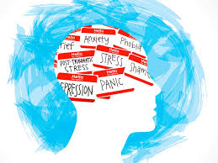
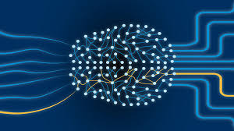
Introduction
Mental Health Disorders Stress, anxiety, and depression are increasingly prevalent in modern society, affecting overall well-being and productivity.
Early Detection Early identification of emotional and stress-related conditions is crucial for timely mental health monitoring and effective intervention.
Speech as an Information Source Human speech carries rich emotional cues—such as pitch, tone, intensity, and speaking rate—which vary significantly with emotional and stress states.
Deep Learning Evolution Speech analysis has evolved from handcrafted features (MFCCs) to self-supervised deep learning models like Wav2Vec2, enabling more robust and generalized emotion recognition directly from raw audio.
Notes:
“Good morning everyone. I’ll begin with a brief introduction to our project.”
Mental health issues such as stress, anxiety, and depression are becoming increasingly common in modern society.
Early detection of emotional and stress-related conditions is important for effective mental health monitoring and timely intervention.
Human speech is a rich source of emotional information—features like pitch, tone, intensity, and speaking rate change with emotional states.
Traditional systems relied on handcrafted features like MFCCs, which often fail to generalize across different speakers and environments.
Recent advances in deep learning, especially self-supervised models like Wav2Vec2, allow us to learn meaningful speech representations directly from raw audio.
Based on this motivation, our project proposes a deep learning-based system to detect emotion and stress from speech signals.
“This forms the foundation and motivation for our work.”

Slide 4
Problem Statement
The problem is the lack of robust and generalized systems for early detection of emotion and stress from speech, especially across diverse speakers and environments.
Rising Mental Health Issues - Stress, anxiety, and depression are increasingly prevalent in modern society.
Need for Early Detection - Early identification is crucial for effective mental health monitoring and timely intervention.
Limitations of Existing Methods - Traditional approaches using handcrafted features (e.g., MFCCs) fail to generalize across speakers and environments.
Research Challenge - Develop a robust, automated deep learning system to detect emotion and stress from speech signals.
Notes:
Existing speech-based systems rely on handcrafted acoustic features like MFCCs, which do not generalize well across different speakers and environments.
As a result, there is a need for a robust and automated deep learning approach.
The challenge is to accurately detect emotion and stress from speech signals in real-world conditions.
“This gap motivates the proposed deep learning-based solution.”

Slide 5

Research Objectives
Design deep learning system for automatic emotion & stress detection from speech signals
Utilize self-supervised Wav2Vec2 for high-level acoustic feature extraction
Model temporal speech dynamics using Bi-directional LSTM network
Implement multi-task learning for joint emotion classification & stress regression
Integrate multiple open-source emotional speech datasets under unified taxonomy
Evaluate performance using standard metrics (accuracy, RMSE)

Slide 6
Literature Survey
Study / Paper | Method / Approach | Features / Models Used | Dataset(s) | Key Findings | Limitation / Gap
Swain et al., 2018 (Survey) | Review of traditional SER | ML & early Deep Learning | Various | Comprehensive overview of features & classifiers in speech emotion recognition. | Focuses mostly on feature-based ML, not modern self-supervised methods. (ResearchGate)
Pepino et al., 2021 | Wav2Vec2.0 embeddings for SER | Self-supervised Wav2Vec2 + NN | RAVDESS, IEMOCAP | Using Wav2Vec2 features improves performance over traditional features. | Only emotion classification, not stress prediction. (ResearchGate)
Wang et al., 2025 | Fine-tuned Wav2Vec2 + NCDE classifier | Transformer + differential equations | IEMOCAP | New architecture for emotion recognition with stability & fast convergence. | Complex model, not widely tested on multiple corpora. (PMC)
Madanian, 2023 | Survey on SER ML methods | Traditional + deep models | Multiple | Identifies challenges of speaker-independent accuracy & evaluation. | Doesn’t use modern transformers like Wav2Vec2. (ScienceDirect)

Slide 7
Literature Survey
Author / Year | Method | Features / Models | Datasets | Key Findings | Limitations
Swain et al., 2018 | Survey | ML & Deep Learning | Multiple | Reviewed classifiers & features. | Focus on traditional features only. (ResearchGate)
Pepino et al., 2021 | Wav2Vec2 Embedding | Self-supervised features | RAVDESS, IEMOCAP | Wav2Vec2 improves emotion recognition. | Only emotion classification. (ResearchGate)
Wang et al., 2025 | Wav2Vec2 + NCDE | Transformer + Differential Eq | IEMOCAP | Stable, accurate emotion recognition. | Only one dataset. (PMC)
Nguyen et al., 2026 | Feature Fusion | Transfer + Prosody | Multi | Fusion enhances generalization. | Doesn’t include stress regression. (ScienceDirect)
Notes:
Previous research in speech emotion recognition mainly used handcrafted features like MFCCs with machine learning models, but these methods showed poor generalization across speakers and environments.
With deep learning, models such as CNNs and LSTMs improved emotion recognition, but most of them still depended on handcrafted features and focused only on emotion classification.
Recent studies introduced self-supervised models like Wav2Vec2, which learn directly from raw speech and provide better robustness. However, most existing works do not address stress prediction, and very few use multi-task learning.
👉 Our work differs by combining Wav2Vec2 with BiLSTM and implementing a multi-task framework that performs emotion classification and continuous stress regression together, trained on multiple datasets for better generalization.

Slide 8
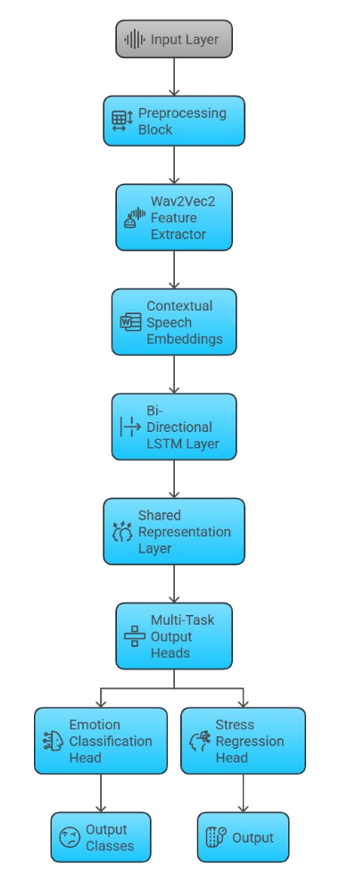
Research Methodology
Input Speech Raw audio waveform
Data Preprocessing Resampling to 16 kHz, normalization
Feature Extraction (Wav2Vec2) Self-supervised speech representations, frozen pretrained layers
Temporal Modeling (Bi-LSTM) Captures bidirectional temporal speech patterns
Multi-Task Output
Emotion Classification: 5 emotion classes
Stress Regression: Continuous stress values
Notes:
We start with raw speech input, which is taken as an audio waveform.
The audio is preprocessed by resampling it to 16 kHz and applying normalization to ensure consistency.
Next, we use a pretrained self-supervised Wav2Vec2 model to extract high-level speech features directly from raw audio. The pretrained layers are frozen to avoid overfitting.
These features are passed to a Bi-directional LSTM, which captures temporal dependencies in both forward and backward directions.
Finally, we use a multi-task learning framework with two outputs:
Emotion classification into five classes
Stress regression to predict continuous stress values
The model is trained using cross-entropy loss for emotion and mean squared error for stress prediction.
“This end-to-end pipeline allows robust emotion and stress detection from speech without using handcrafted features.”
This approach combines self-supervised learning with temporal modeling and multi-task learning to improve generalization and robustness.

Slide 9
Result/Discussions
🟢 Green = Best performance 🔵 Blue = Strong / Second-best
Angry emotion achieves the highest F1-score (0.96)
Fear shows the highest recall (0.80), indicating strong detection of high-arousal emotions.
Achieved 85.9% overall emotion
classification accuracy
5 emotion classes: Neutral, Happy, Sad, Angry, Fear
Stress prediction performance:
MSE: 0.0826
RMSE: 0.1268 (low error, good regression accuracy)
Emotion Class | Precision (%) | Recall (%) | F1-Score (%)
Neutral | 0.71 | 0.03 | 🔵 0.83
Happy | 🔵 0.94 | 0.68 | 0.79
Sad | 🔵 0.94 | 🔵 0.74 | 🔵 0.83
Angry | 🟢 0.96 | 0.70 | 🟢 0.96
Fear | 0.87 | 🟢 0.80 | 0.76

Slide 10
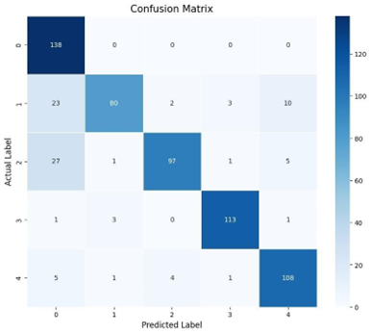
Result/Discussions
High values along the diagonal indicate accurate emotion classification
Angry and Neutral emotions show the highest correct predictions
Minor confusion observed between similar emotions (Neutral–Happy, Sad–Fear)
High-arousal emotions are classified more accurately
No major class imbalance or bias observed
Confirms robust and stable model performance
Notes:
The confusion matrix shows high values along the diagonal, which indicates accurate emotion classification across all classes.
Angry and Neutral emotions have the highest correct predictions, showing strong model confidence for these emotions.
We observe minor confusion between similar emotions, such as Neutral–Happy and Sad–Fear, which is expected due to overlapping speech characteristics.
High-arousal emotions, like Angry and Fear, are classified more accurately compared to low-arousal emotions.
There is no major class imbalance or prediction bias, indicating balanced learning across emotion classes.
Overall, the results confirm that the proposed model is robust, stable, and reliable for emotion and stress detection from speech.
“These results validate the effectiveness of our Wav2Vec2–BiLSTM multi-task framework.”

Slide 11


Scope of Project
Emotion classification into five emotions
Stress regression based on emotional arousal
Multi-dataset generalization using RAVDESS, TESS, and SAVEE
End-to-end deep learning pipeline from raw speech input
Model suitable for mental health monitoring applications
Integration with doctor’s clinics and hospitals
Support for mental health assessment tools
Deployable as standalone modules or integrated with existing healthcare systems
Notes:
The project focuses on speech-based emotion classification into five classes: Neutral, Happy, Sad, Angry, and Fear.
It also includes continuous stress regression, where stress levels are estimated from emotional arousal.
The model is trained and evaluated on multiple datasets—RAVDESS, TESS, and SAVEE—to ensure better generalization across speakers and environments.
The system is designed as an end-to-end deep learning pipeline using raw speech input without handcrafted features.
The scope also includes making the model deployment-ready for mental health monitoring applications.
“Overall, the project scope covers both research and practical deployment aspects.”
If asked “What is not included in your scope?”, say:
“Clinical diagnosis and real-time multimodal sensing are outside the current scope.”

Slide 12
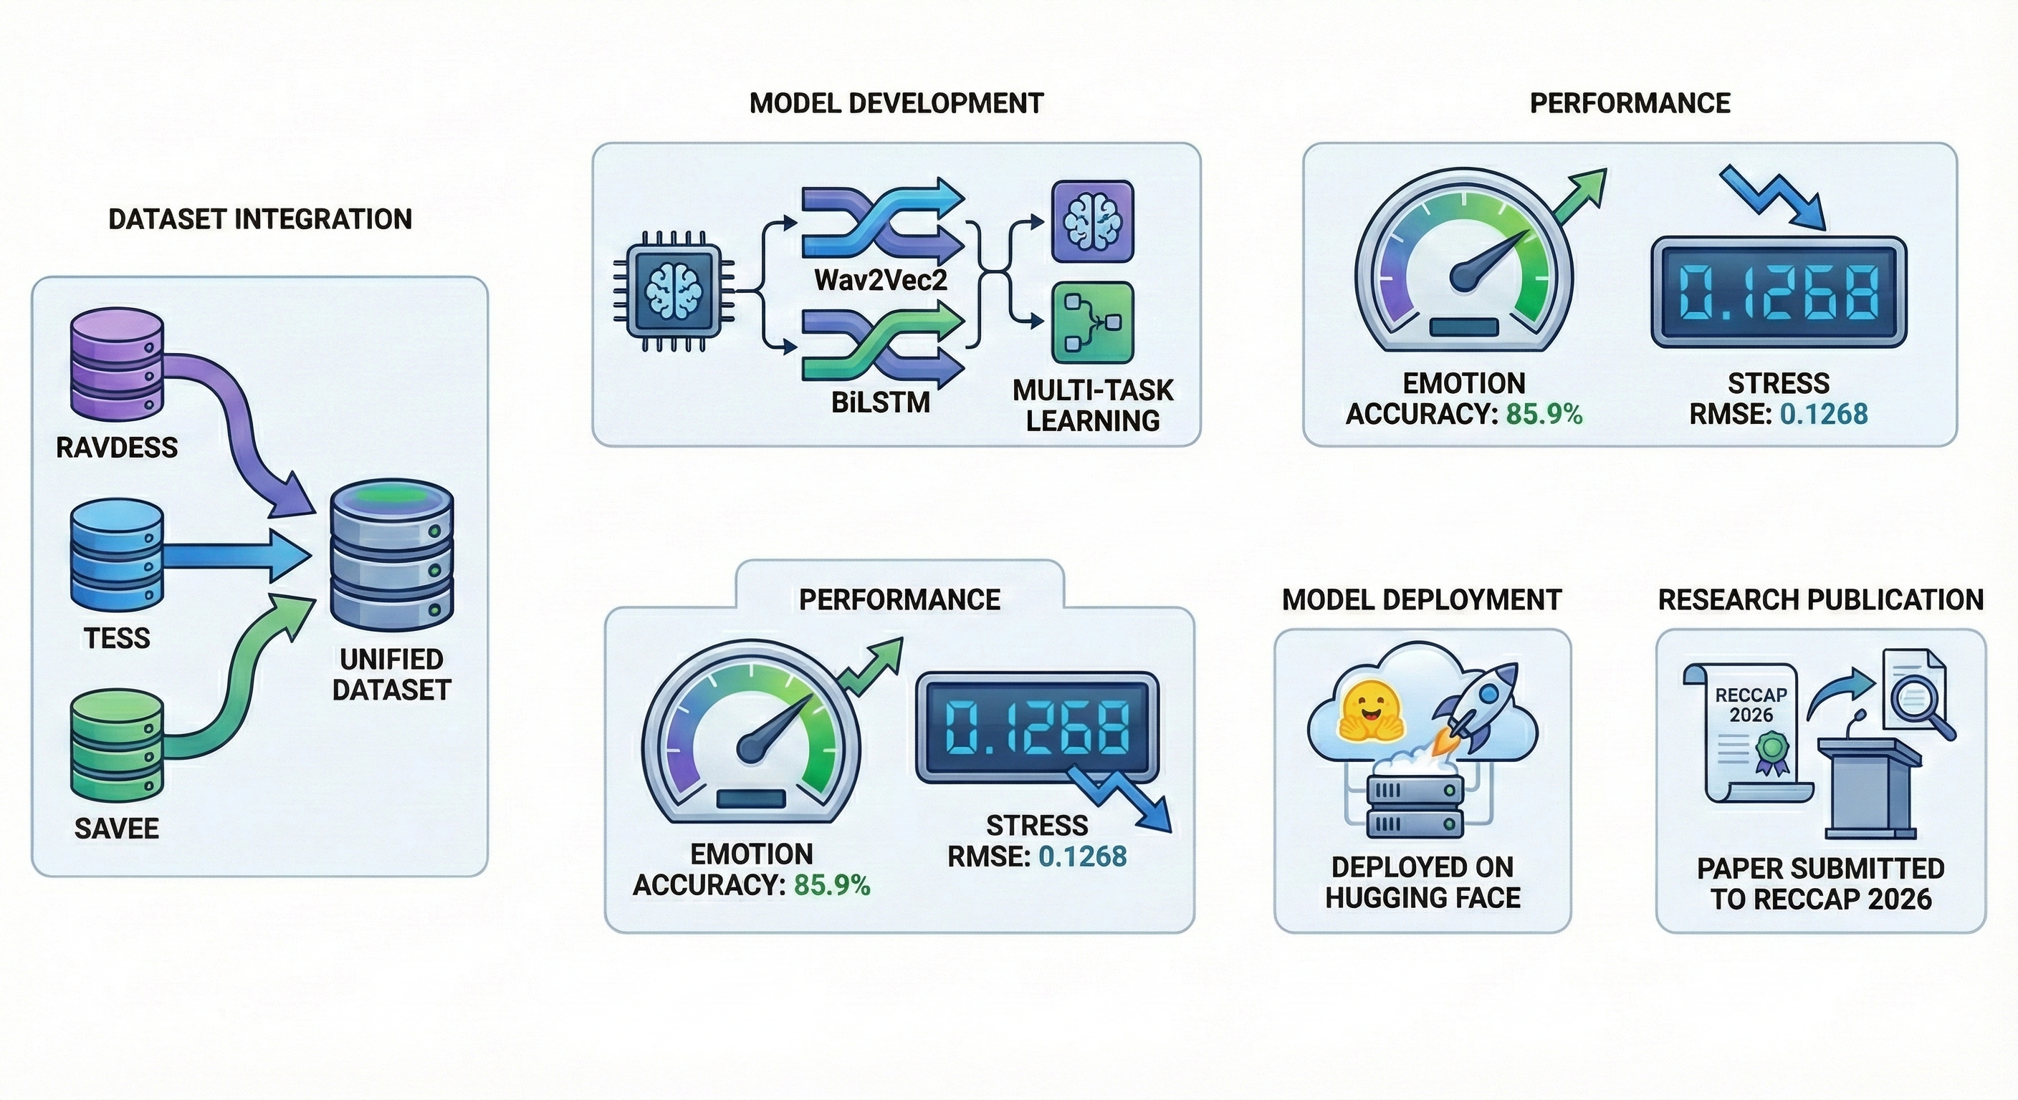
Progress so Far
Dataset Integration
Unified RAVDESS, TESS, and SAVEE datasets
Model Development
Hybrid Wav2Vec2–BiLSTM with multi-task learning
Performance
Emotion Accuracy: 85.9%
Stress RMSE: 0.1268
Model Deployment
Deployed on Hugging Face for reproducibility
Research Publication
Paper submitted to RECCAP 2026

Slide 13
References
[1] A. Baevski et al., wav2vec 2.0: A framework for self-supervised learning of speech representations, NeurIPS, 2020.
[2] S. Schneider et al., wav2vec 2.0, IEEE/ACM Transactions on Audio, Speech, and Language Processing, 2021.
[3] S. Hochreiter & J. Schmidhuber, Long Short-Term Memory, Neural Computation, 1997.
[4] B. Schuller & A. Batliner, Speech Emotion Recognition: Two Decades in a Nutshell, Communications of the ACM, 2018.
[5] S. R. Livingstone & F. A. Russo, RAVDESS: Ryerson Audio-Visual Database of Emotional Speech and Song, PLOS ONE, 2018.
[6] K. Dupuis & M. K. Pichora-Fuller, Toronto Emotional Speech Set (TESS), 2010.
[7] S. Sahu, Hybrid Wav2Vec2–BiLSTM Model for Emotion and Stress Detection from Speech, Hugging Face Model Hub
[8] Y. LeCun, Y. Bengio, and G. Hinton, Deep Learning, Nature, 2015.

Slide 14
Thank you

